Slide 1
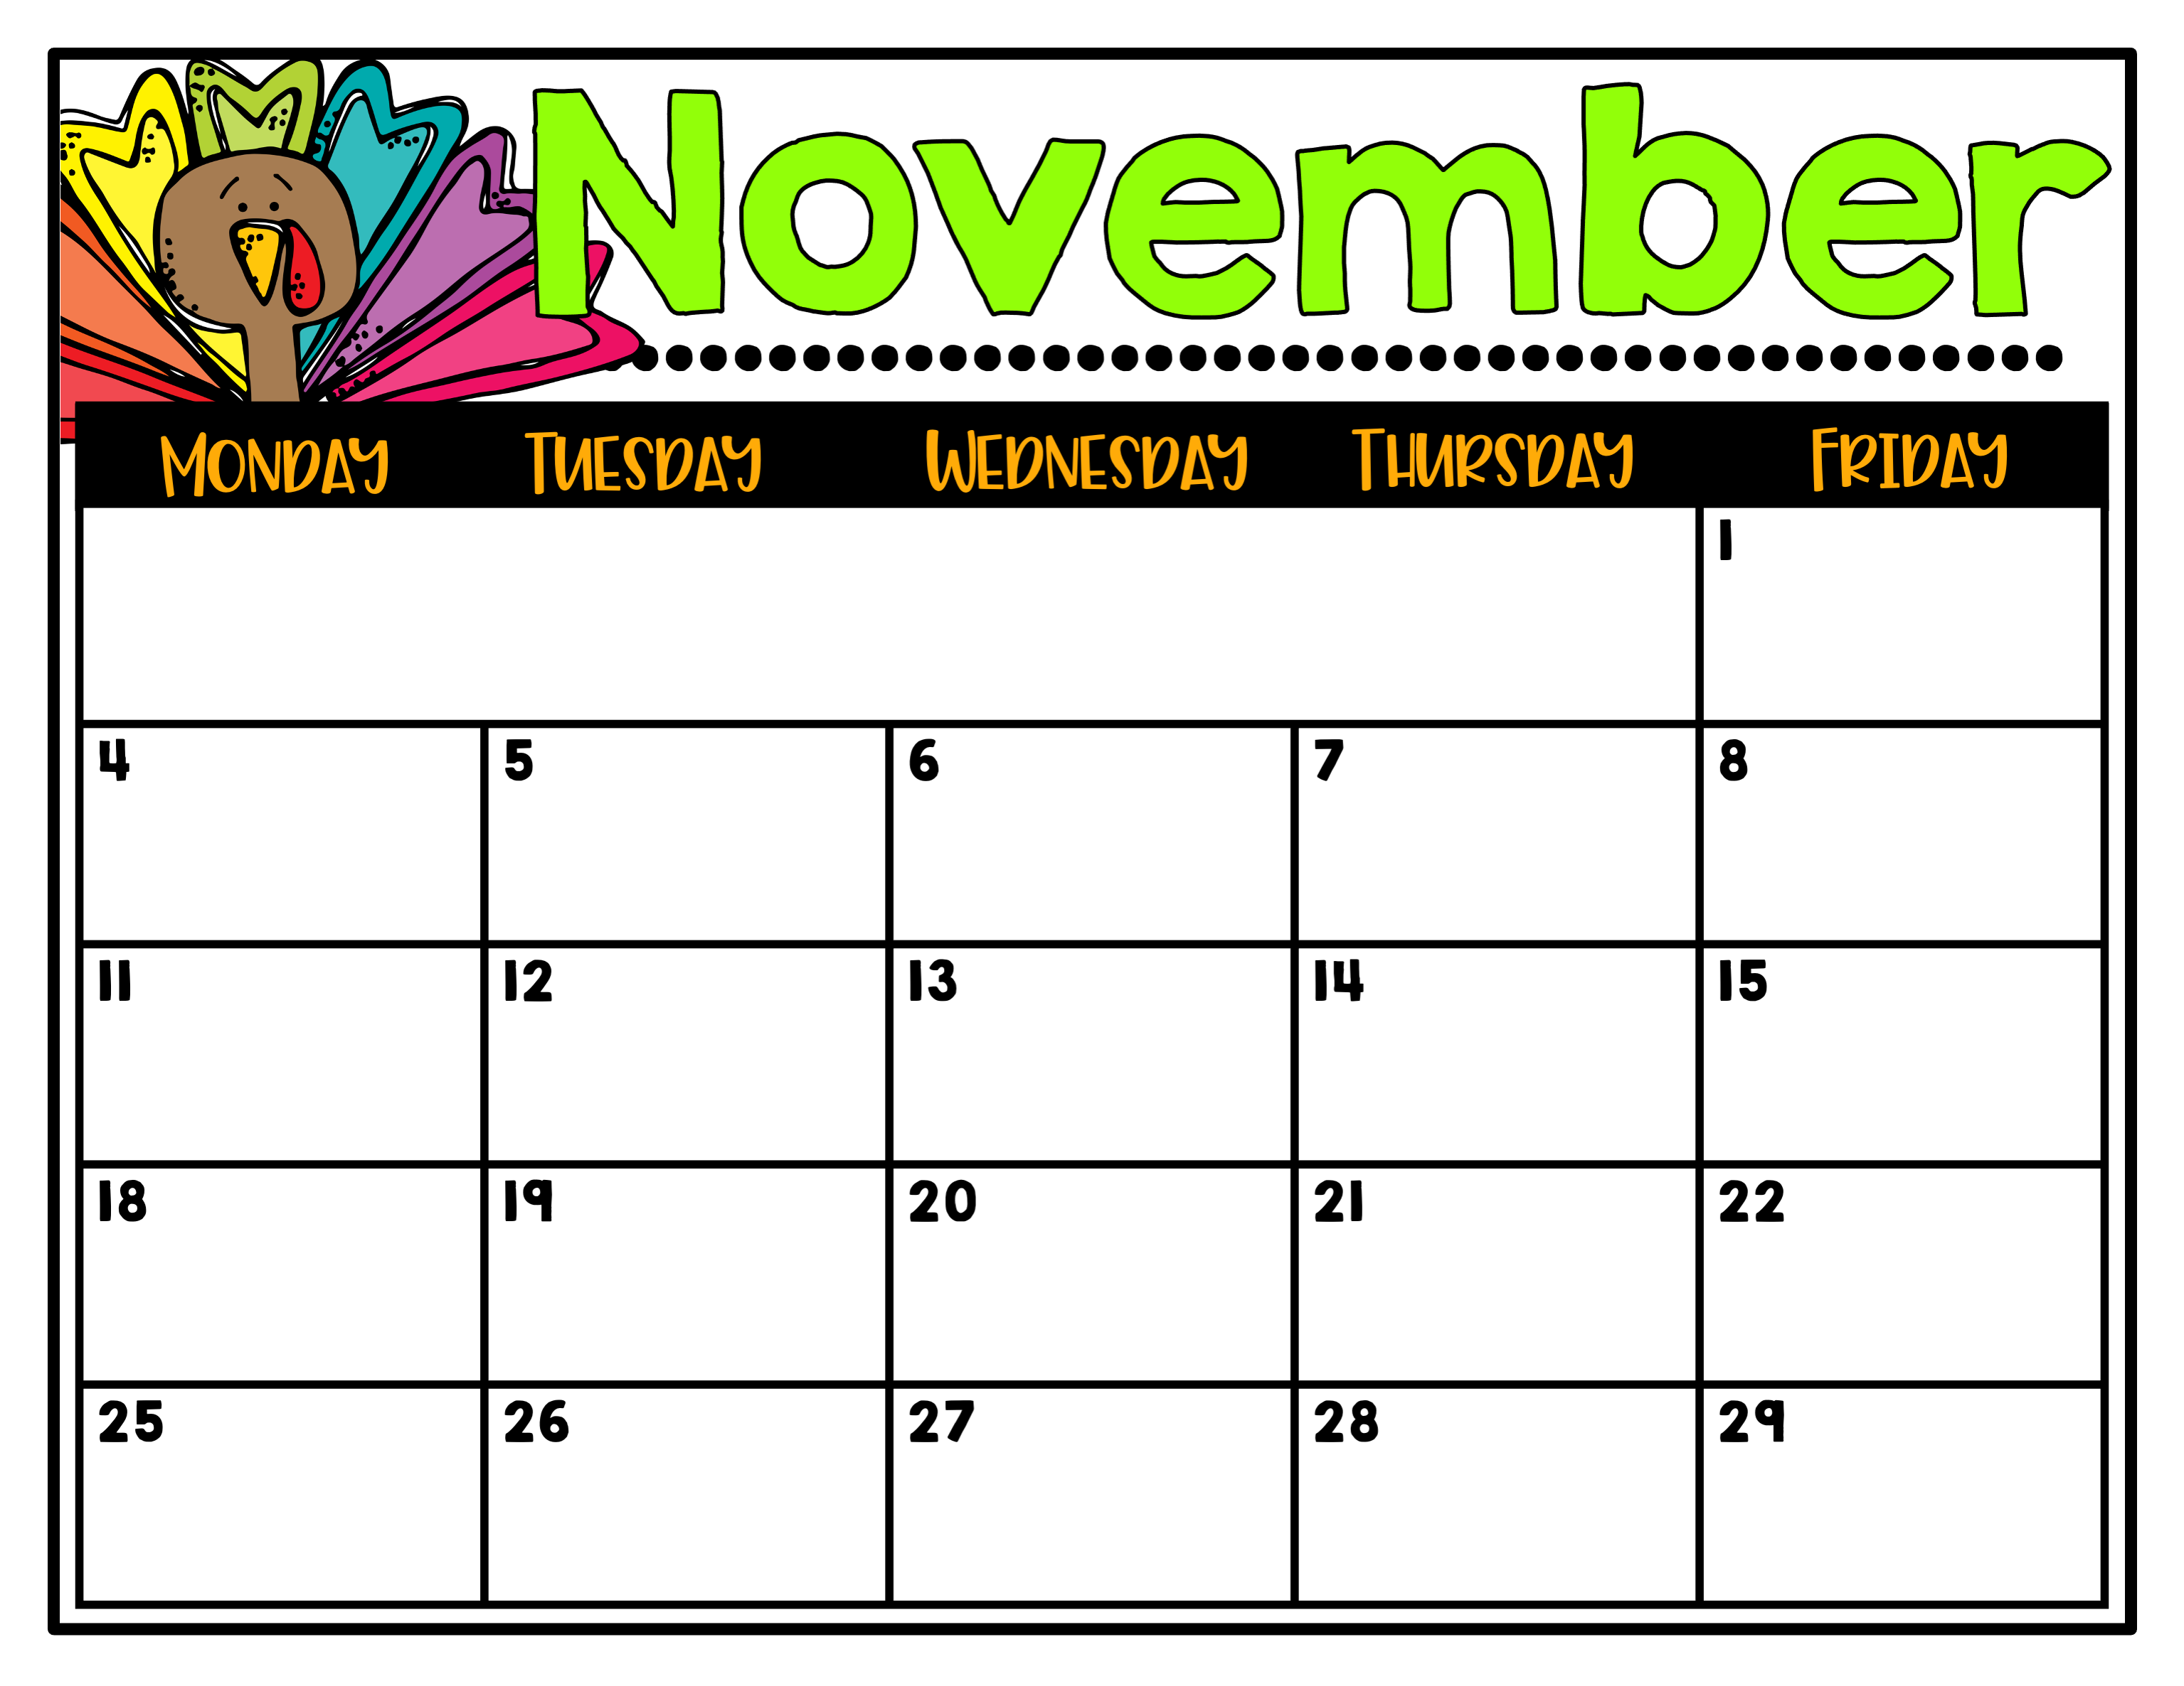
Mrs. Darden’s
Special Area Schedule
Bobcat
Blitz
Day 1
Music
Day 2
P.E.
Day 3
Guidance
Day 4
Art
Day 5
P.E.
Day 6
Library
Day 1
Music
Day 2
P.E.
Day 3
Guidance
Veterans Day
No School
Day 4
Art
Day 5
P.E.
Day 6
Library
Day 1
Music
Day 2
P.E.
Thanksgiving Holiday No School

